Slide 1
Anti corruption cases vs arrests
Q7Anti corruption cases vs arrests.
Query:-
SELECT A.area_name , sum (A.AC02_No_of_cases_registered_during_the_year) as total_cases_registerd ,
sum (B.ACA02_No_of_persons_arrested_during_the_year) as Total_arrested_Person
from "23_Anti_corruprion_cases" as A
inner join "24_Anti_corruption_arrests" as B
on A.area_name = B.area_name
GROUP by A.area_name
ORDER BY sum(A.AC02_No_of_cases_registered_during_the_year) DESC;

Slide 2
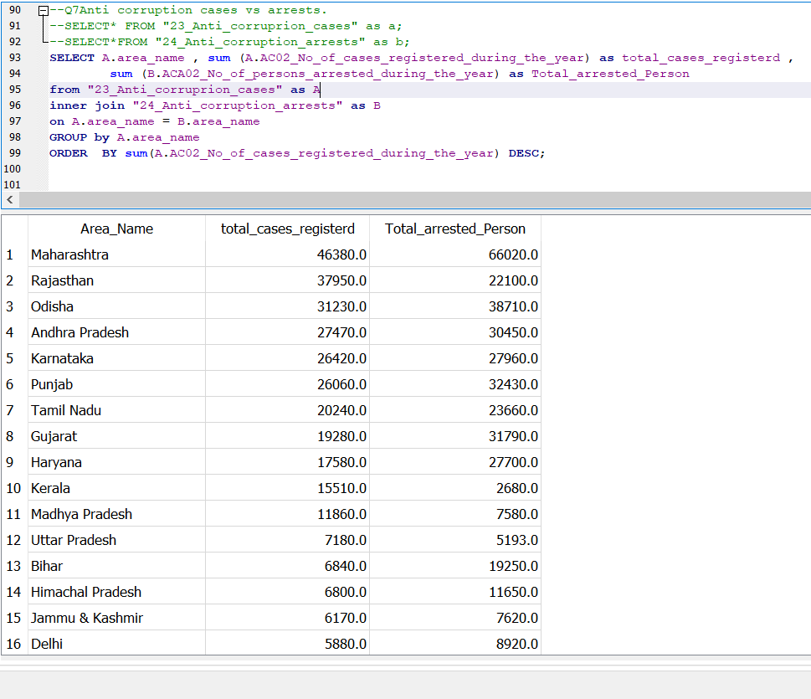
Our query screenshot:-

Slide 3
